Slide 1

Risk Management
Name: Pritam Suwal Shrestha
Student Id: 23771397
An Inherent Component of Projects
With strategic management, risks associated with schedule, budget, quality, and stakeholders can be systematically identified, analysed, and managed
Allows teams to leverage insights gained from managing risks to enhance decision-making, refine strategies, and strengthen resilience against future challenges
Notes:
I am Pritam. Today, I'll highlight the vital role of risk management in the Kidston Solar Project Phase 1.
Risk management is essential in projects to navigate the uncertainties related to schedule, budget, quality, and stakeholders. It involves systematic identification, analysis, and management of potential risks to enhance decision-making and refine strategies.

Slide 2

Risk Assessment
Name: Pritam Suwal Shrestha
Student Id: 23771397

Slide 3

Environmental and Social Considerations
Name: Pritam Suwal Shrestha
Student Id: 23771397
Initial risk assessment focused on potential objections from local landowners and biodiversity concerns
Location on an abandoned mine site minimized environmental and social risks
Notes:
For the solar project, Genex initiated with a thorough risk assessment, prioritizing environmental and social considerations. It evaluated potential objections from local landowners and biodiversity concerns. However, the project’s location on an abandoned mine site significantly minimized these environmental and social risks.

Slide 4

International Procurement and Financial Risks
Name: Pritam Suwal Shrestha
Student Id: 23771397
Equipment sourced from international suppliers like First Solar , SMA , and NEXTracker
Foreign exchange financial risk introduced additional complexities for project financing
Inexperienced teams heightened risks due to uncertainty in costs and lack of historical data on similar projects
Notes:
Genex sourced equipment from international suppliers like First Solar (US), NEXTracker (US).
and SMA (Germany). This introduced foreign exchange financial risks and given the team’s inexperience with such large-scale solar projects, it also increased the uncertainty around costs due to the lack of historical data.

Slide 5
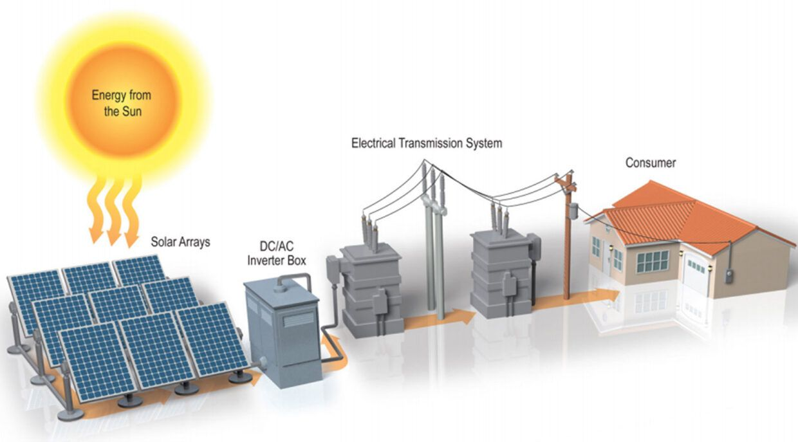

Grid Connection Challenges
Name: Pritam Suwal Shrestha
Student Id: 23771397
Grid connection providers often being government entities resulted in non-negotiable terms on price and connection timing
Grid connection was identified as the longest and riskiest part of the project
Notes:
Grid connection involves dealing with government entities like Ergon Energy that set firm terms for price and timing.
Identifying grid connection as the lengthiest and riskiest part of the project shaped their approach to this critical phase.

Slide 6

Planning Stage Risk Management
Name: Pritam Suwal Shrestha
Student Id: 23771397

Slide 7


Risk Transfer Mechanism
Name: Pritam Suwal Shrestha
Student Id: 23771397
Genex transferred construction and finalisation risks to UGL, ensuring they handled potential issues like equipment malfunctions or construction delays
Notes:
In response, during the planning stage, Genex implemented a risk transfer mechanism by shifting construction and finalization risks to UGL.

Slide 8
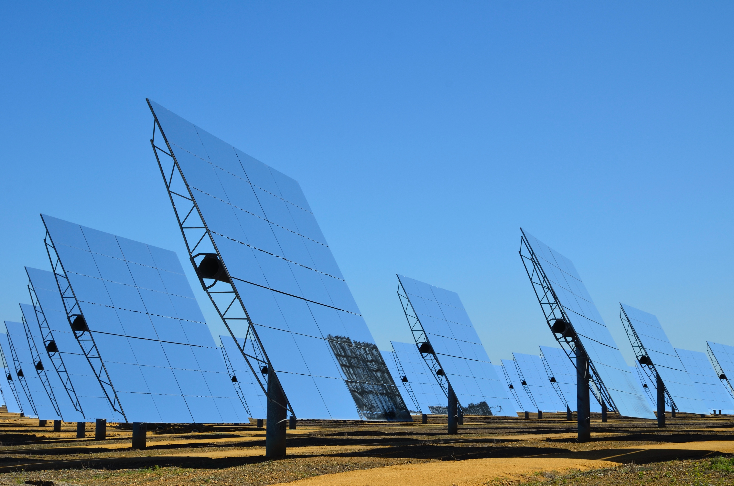



Revenue Assurance
Name: Pritam Suwal Shrestha
Student Id: 23771397
Power Purchase Agreements signed with Origin Energy and Energy Australia for 10 to 20 years, enhancing revenue certainty
Notes:
They also assured revenue through Power Purchase Agreements with Origin Energy and Energy Australia, mitigating financial risk and guaranteeing stable income for the future

Slide 9

Execution and Future Risk Management Strategies
Name: Pritam Suwal Shrestha
Student Id: 23771397

Slide 10
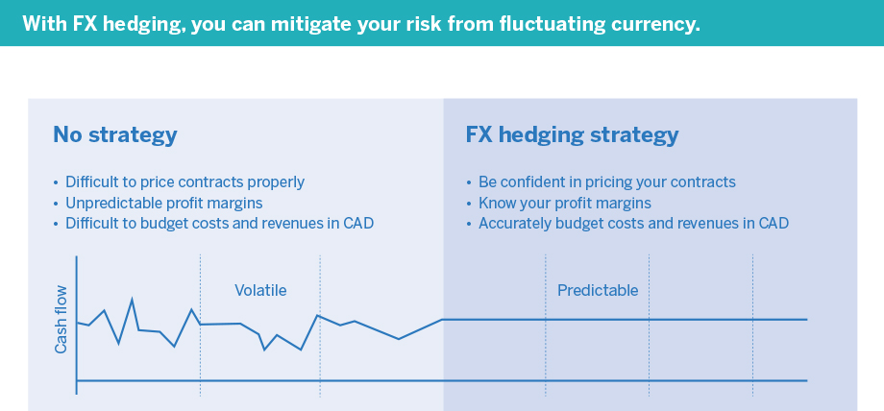

Enhanced Hedging Mechanisms
Name: Pritam Suwal Shrestha
Student Id: 23771397
Implement more sophisticated hedging mechanisms like forward and futures contracts to mitigate unforeseen market volatility
Notes:
Although, simple hedging mechanisms were used, Genex realized the importance of sophisticated hedging mechanisms to mitigate market volatility. We recommend the use of forward and futures contracts to prevent any risks associated with it. Because, it helps to know the profit margins and accurately budget costs and revenues.

Slide 11

Risk Register Utilization
Name: Pritam Suwal Shrestha
Student Id: 23771397
Use of a risk register to identify potential setbacks within the project and implement controls for better project budget management and stakeholder expectation management
Risk Event | Probability | Impact | Priority | Strategy | Accountability
Grid Connection Delays | 4 | Catastrophic (5) | 20 | Expedite negotiations and approvals with grid operators | Project Manager
Cost Overruns due to Currency Fluctuations | 3 | Major (4) | 12 | Implement financial hedging strategies | Financial Manager
Supply Chain Disruptions for Solar Panels | 3 | Major (4) | 12 | Develop alternative supplier relationships | Procurement Manager
Environmental Permit Delays | 2 | Moderate (3) | 6 | Engage early with regulatory bodies | Environmental Officer
Community Opposition | 2 | Moderate (3) | 6 | Strengthen community engagement plans | Community Liaison
Notes:
We also recommend use of risk register to track potential project setbacks, ensuring robust controls for budget management and ensuring stakeholder expectations

Slide 12

PESTELG Framework Application
Name: Pritam Suwal Shrestha
Student Id: 23771397
Identification of external factors impacting the project including Political, Economic, Social, Technological, Environmental, Legal, and Global factors
Emphasis on early engagement with grid operators and regulatory authorities to avoid project delays
Notes:
To anticipate and manage external impacts, we suggest the use of PESTELG framework to identify key factors like political, economic, and legal influences.

Slide 13

Comprehensive Feasibility Studies
Name: Pritam Suwal Shrestha
Student Id: 23771397
Advised to conduct extensive studies beyond solar radiation richness to identify and plan for potential challenges
Adequate budgeting and resource allocation for timely grid connection completion recommended
Notes:
Additionally, we will recommend Genex for comprehensive feasibility studies beyond solar radiation metrics to ensure thorough preparation for potential obstacles during the project
We will also suggest them to allocate enough budget and resource to avoid any delays regarding grid connection

Slide 14
Risk Management
An Inherent Component of Projects
With strategic management, risks associated with schedule, budget, quality, and stakeholders can be systematically identified, analysed, and managed
Allows teams to leverage insights gained from managing risks to enhance decision-making, refine strategies, and strengthen resilience against future challenges

Slide 15
Risk Assessment

Slide 16
Environmental and Social Considerations
Initial risk assessment focused on potential objections from local landowners and biodiversity concerns
Location on an abandoned mine site minimized environmental and social risks

Slide 17
International Procurement and Financial Risks
Equipment sourced from international suppliers like First Solar , SMA , and NEXTracker
Foreign exchange financial risk introduced additional complexities for project financing
Inexperienced teams heightened risks due to uncertainty in costs and lack of historical data on similar projects

Slide 18
Grid Connection Challenges
Grid connection providers often being government entities resulted in non-negotiable terms on price and connection timing
Grid connection was identified as the longest and riskiest part of the project

Slide 19
Planning Stage Risk Management

Slide 20
Risk Transfer Mechanism
Genex transferred construction and finalization risks to UGL, ensuring they handled potential issues like equipment malfunctions or construction delays

Slide 21
Revenue Assurance
Power Purchase Agreements signed with Origin Energy and Energy Australia for 10 to 20 years, enhancing revenue certainty

Slide 22
Execution and Future Risk Management Strategies

Slide 23
Enhanced Hedging Mechanisms
Implement more sophisticated hedging mechanisms like forward and futures contracts to mitigate unforeseen market volatility

Slide 24
Risk Register Utilization
Use of a risk register to identify potential setbacks within the project and implement controls for better project budget management and stakeholder expectation management
Risk Event | Probability | Impact | Priority | Strategy | Accountability
Grid Connection Delays | 4 | Catastrophic (5) | 20 | Expedite negotiations and approvals with grid operators | Project Manager
Cost Overruns due to Currency Fluctuations | 3 | Major (4) | 12 | Implement financial hedging strategies | Financial Manager
Supply Chain Disruptions for Solar Panels | 3 | Major (4) | 12 | Develop alternative supplier relationships | Procurement Manager
Environmental Permit Delays | 2 | Moderate (3) | 6 | Engage early with regulatory bodies | Environmental Officer
Community Opposition | 2 | Moderate (3) | 6 | Strengthen community engagement plans | Community Liaison

Slide 25
PESTELG Framework Application
Identification of external factors impacting the project including Political, Economic, Social, Technological, Environmental, Legal, and Global factors
Emphasis on early engagement with grid operators and regulatory authorities to avoid project delays

Slide 26
Comprehensive Feasibility Studies
Advised to conduct extensive studies beyond solar radiation richness to identify and plan for potential challenges
Adequate budgeting and resource allocation for timely grid connection completion recommended

